Slide 1
CGB1201 – JAVA PROGRAMMING SEMESTER REVIEW
Department of CSE
Artificial Intelligence Machine Learning
Academic Year: 2024 – 2025 (Odd Semester)
Register Number : 8115U23AM048
Name : SIVAHARI AKILAN S
Year : SECOND YEAR
Semester : III
Date : 5.12.24

Slide 2
Title of the Project
INVENTORY MANAGEMENT SYSTEM

Slide 3
Abstract
The Inventory Management System simplifies the management of product data, such as item names, prices, and quantities, using a graphical user interface (GUI). It supports adding, updating, and deleting items while calculating total items and total costs dynamically. This project utilizes Java Swing for interactive interfaces and follows an object-oriented design for modular functionality.

Slide 4
Abstract with CO/PO Mapping
Abstract | CO | POs | PSO
The Inventory Management System simplifies the management of product data, such as item names, prices, and quantities, using a graphical user interface (GUI). It supports adding, updating, and deleting items while calculating total items and total costs dynamically. This project utilizes Java Swing for interactive interfaces and follows an object-oriented design for modular functionality. | CO1 CO2 CO3 CO4 CO5 | PEO1 PEO2 PEO3 | PSO1 PSO2

Slide 5
Introduction
Managing inventory efficiently is crucial for businesses to optimize resources and track stock effectively. This project addresses the need for an intuitive system that integrates user-friendly design with essential inventory management features. Built using Java Swing, this application is suitable for small businesses and educational purposes.

Slide 6
Java Programming - Concepts Used
The Inventory Management System leverages Java Swing for creating an interactive GUI, using concepts like event-driven programming for button actions and object-oriented principles for modularity. It employs JTable for data representation, JPanel for structured layout, and JScrollPane for enhanced data visualization. Dynamic updates of total items and costs ensure real-time feedback, while input validation maintains data integrity, resulting in a user-friendly and efficient inventory solution.

Slide 7
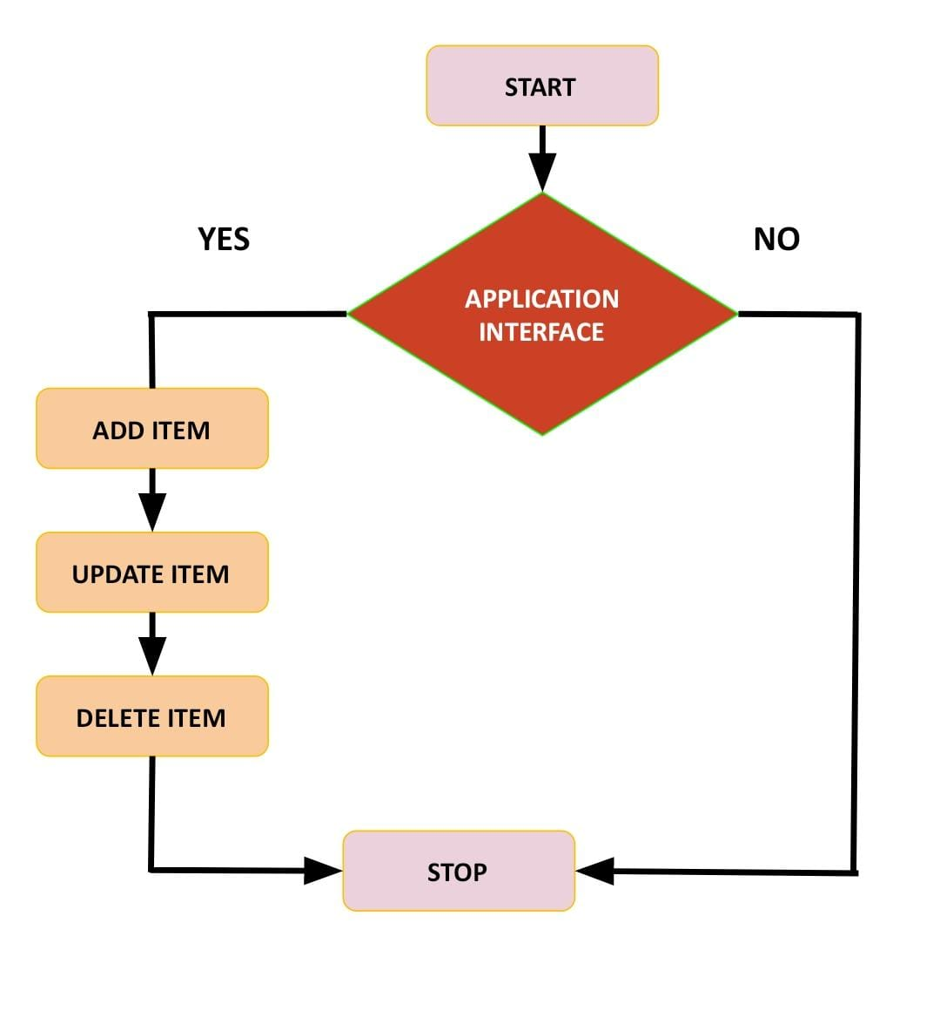
Proposed Architecture

Slide 8
Proposed Architecture - Description
The program starts by creating the user interface with Swing components like a ‘Jtable’ for inventory, ‘JTextField’ for input, and ‘Jbutton’ for actions. Layouts such as ‘BorderLayout’ and ‘FlowLayout organize these components with padding and color for a clean design. The design ensures a user-friendly experience.
Clicking "Add Item" validates input, adds the item to the table, and updates the total items and cost by multiplying price and quantity. Invalid inputs trigger alerts for corrections, ensuring the accuracy of user entries.

Slide 9
Proposed Architecture - Description (Cont..)
To update an item, users select a row, edit the input fields, and click "Update Item." The table is updated, and the total cost is recalculated for accuracy. This operation allows users to modify existing entries effectively.
The "Delete Item" button removes a selected row and updates the total items and cost by recalculating the table data. Proper error handling ensures smooth and user-friendly operation, keeping the inventory consistent.

Slide 10
List of Modules
Add Item
Update Item
Delete Item

Slide 11
Module Description
ADD ITEM :
Allows the user to add a new item to the inventory by entering the item's name, price, and quantity. The total items and total cost are updated accordingly.

Slide 12
Module Description (Cont..)
UPDATE ITEM :
Allows the user to select an existing item from the table, modify its details (name, price, and quantity), and update the table. The total cost is recalculated after the update.

Slide 13
Module Description (Cont..)
DELETE ITEM :
Allows the user to select an item from the table and delete it from the inventory. The total items and total cost are updated after the deletion.

Slide 14
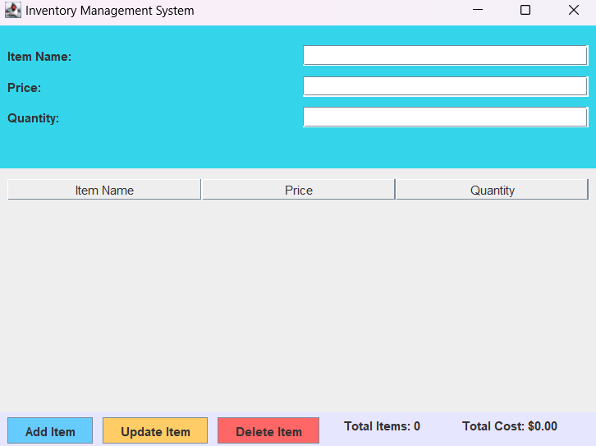
Results and Discussion

Slide 15
Results and Discussion (Cont..)
RESULTS:
The program tracks item names, prices, and quantities. It calculates and displays the total cost and number of items. The functionalities meet the basic inventory management system requirements.

Slide 16
Results and Discussion (Cont..)
DISCUSSION:
The program allows users to manage inventory by adding, updating, and deleting items. It updates the total items and cost as actions are performed. The table-based display clearly shows the inventory data.

Slide 17
Conclusion
This Inventory Management System serves as a practical tool for managing inventory efficiently. It showcases Java's capability for creating interactive and reliable applications, fulfilling the core objectives of simplicity, accuracy, and usability in inventory management.

Slide 18

Thank You

